Slide 1

FudgeMart Inc. Data Warehouse & Business Intelligence Solution
Ist722 - Group2 : Keeley Ables, Steve Lamarre,
Subbu Kandhaswamy, Zachary agrue.

Slide 2


Business Overview
FudgeMart is an online retail business that operates similar to Walmart, Flipkart etc. All business transaction related data for Fudgemart are stored in relational database (fudgemart) and includes Customers, Product, Supplier, Orders, Reviews and Employee tables.
FudgeFlix is another fictitious DVD Rental company and subsidiary of Fudgemart that operates online to serve rental DVD and On-demand streaming services like Netflix. The business operation data stored in fudgeflix_v3 database and includes plans, customers, Orders & employees.
FudgeMart sells home furnishing products to customers in an online store. FudgeFlix sells subscriptions to customers based on the plans.
Tracking their Sales and customer satisfaction (Reviews) for both subsidiary will enable us to track the growth of company.

Slide 3
Project Goals
Date Warehouse using OLTP Source using ETL process.
Build Analytical Reports focusing Sales & Customer Satisfaction using BI platform (Power BI)
Enable Fudgemart Inc to Review, Plan and make Decisions for business growth using aggregated sales trends by region, product, category and periods.

Slide 4

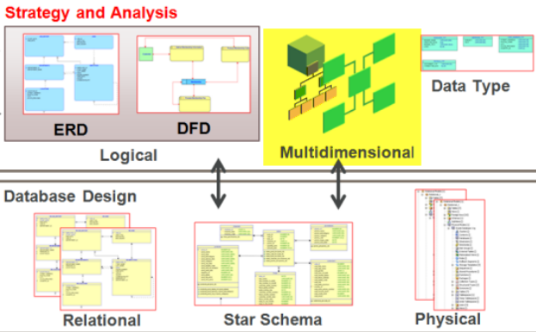
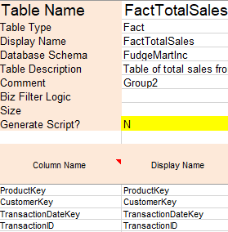
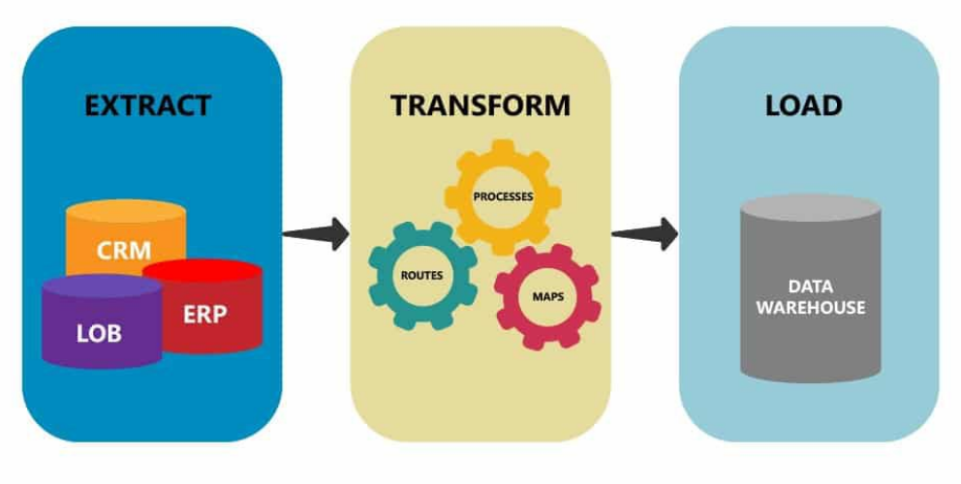

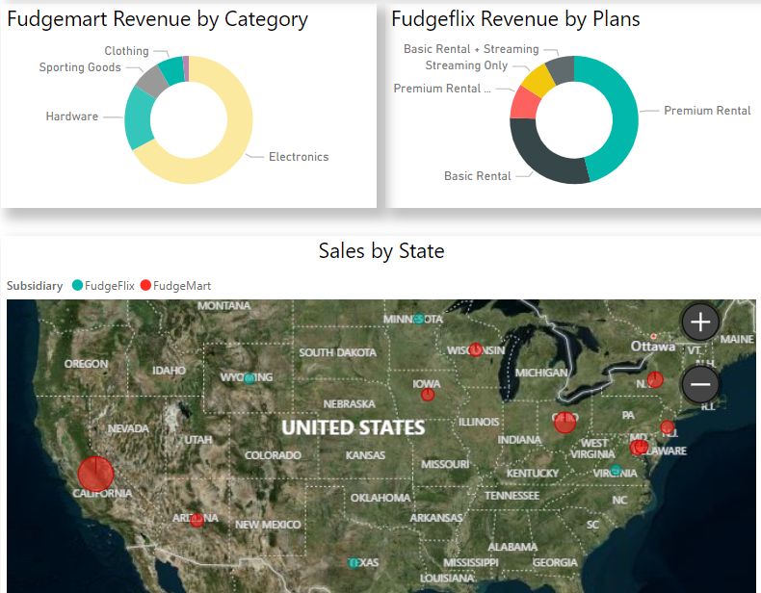

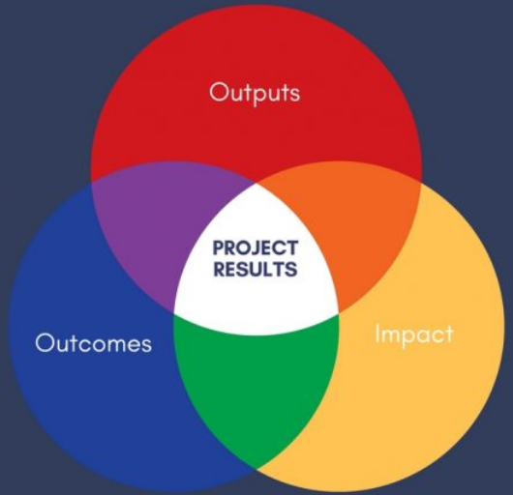
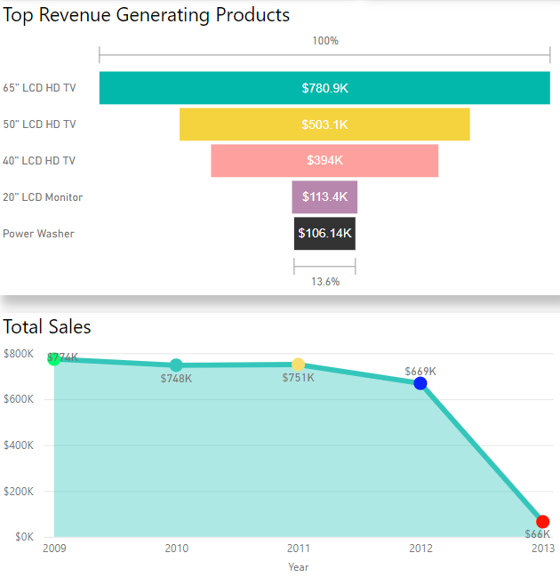
Deliverables
Project Charter
High-level Model
Detailed Dim Model
ETL Operation
Data Warehouse
BI Dashboard
Presentation
Outcome/Results

Slide 5
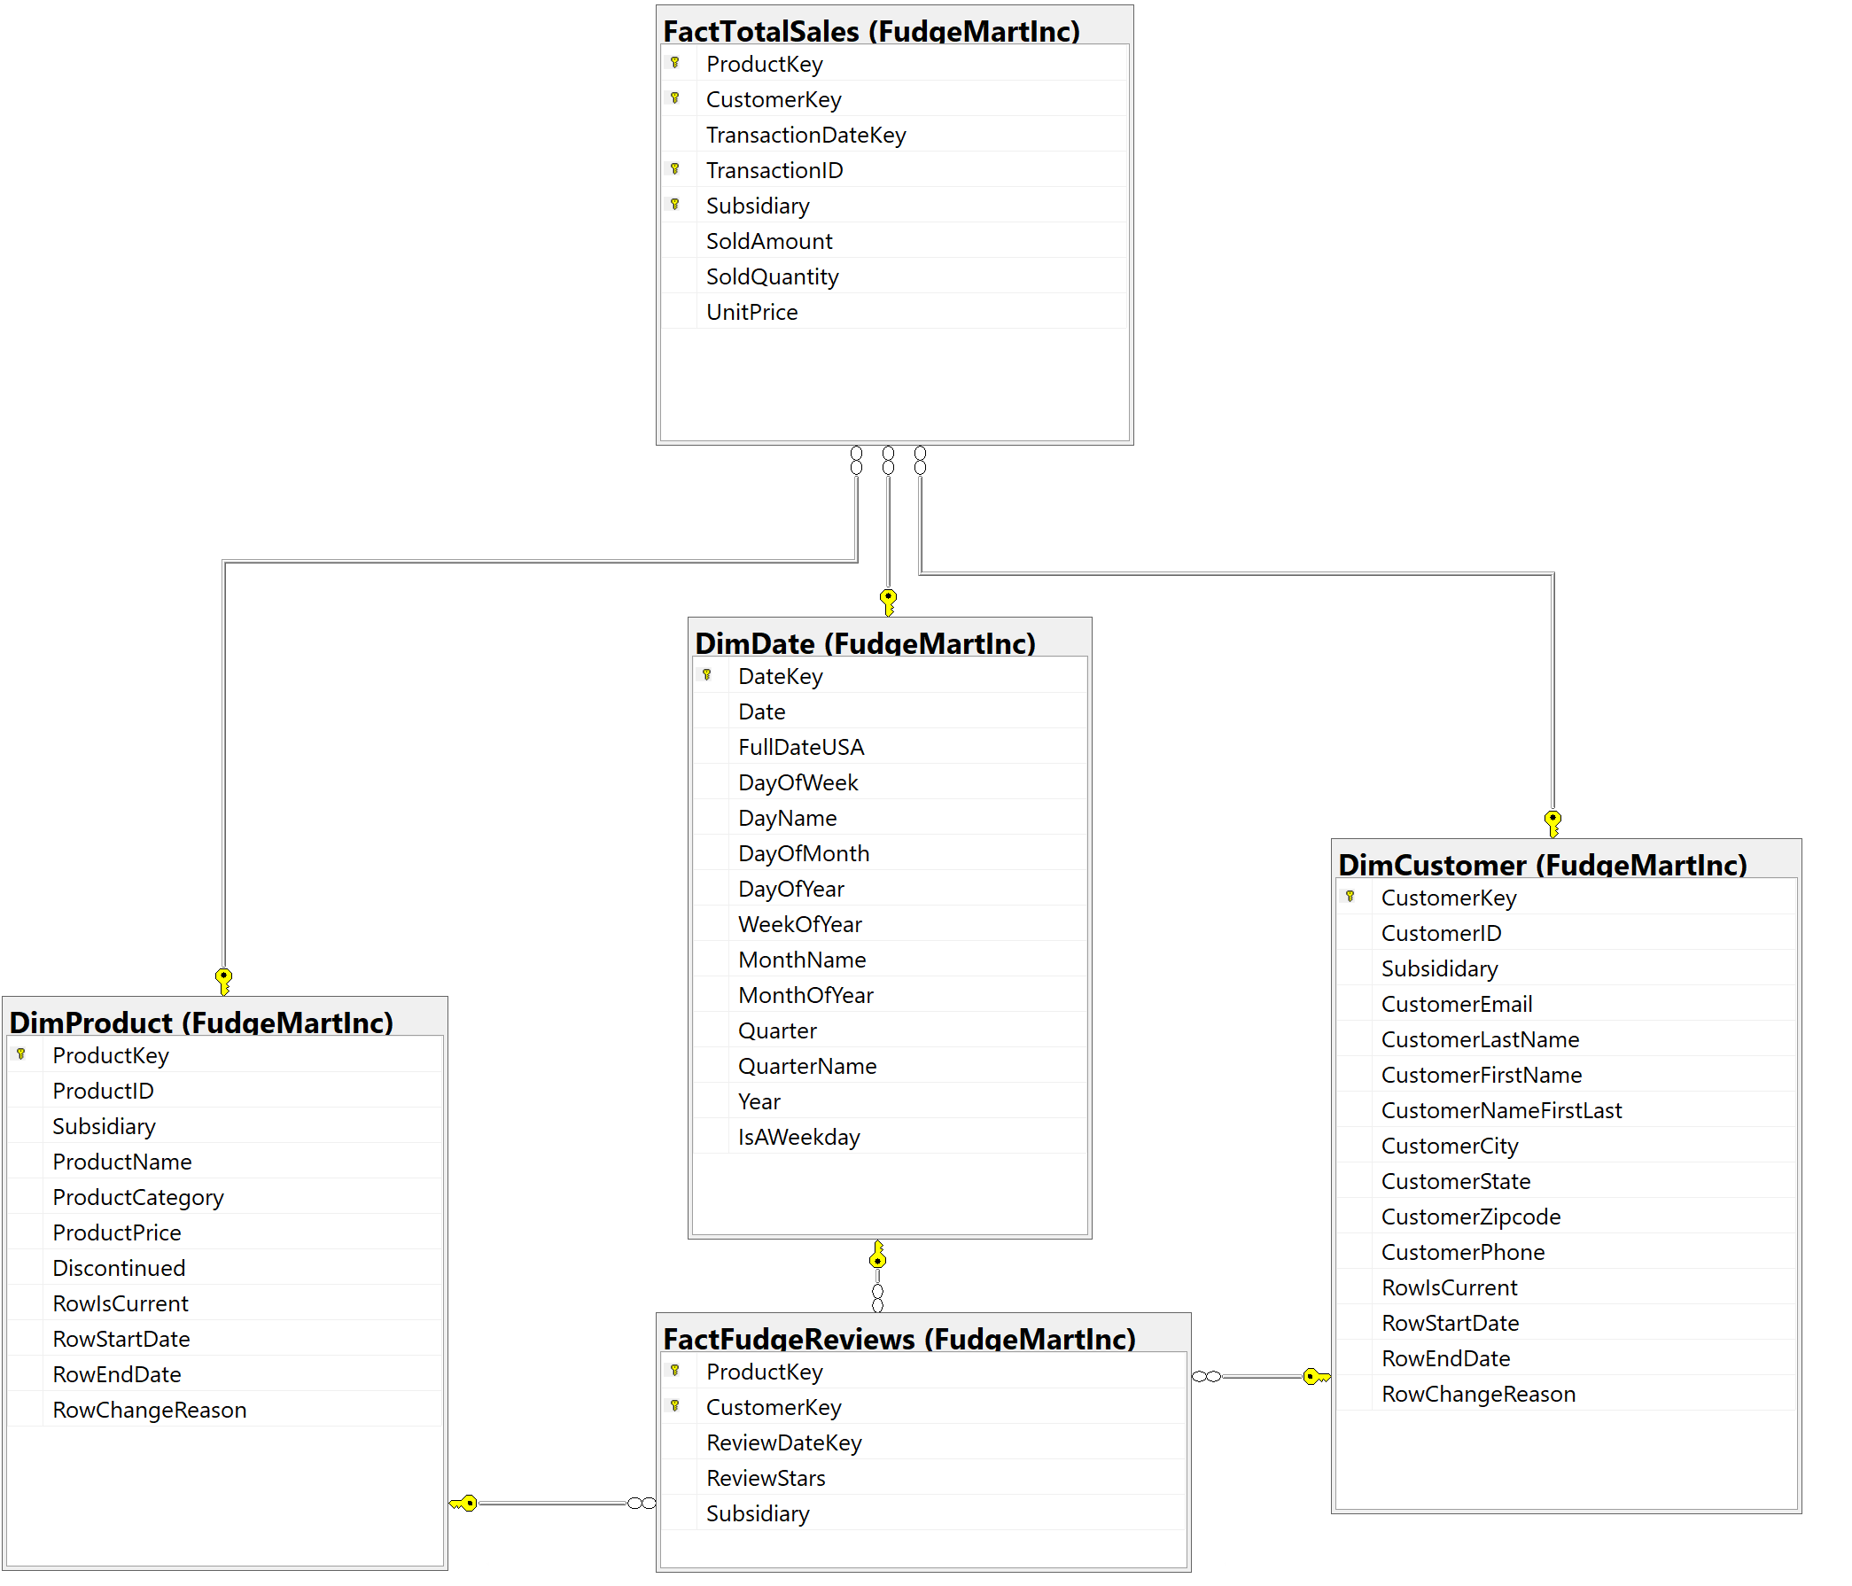
Star Schema

Slide 6
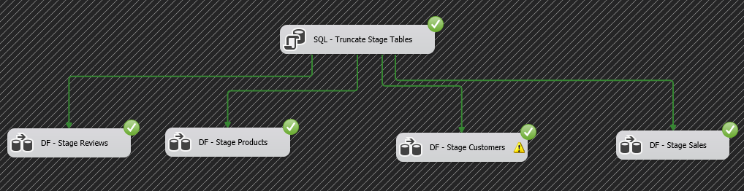
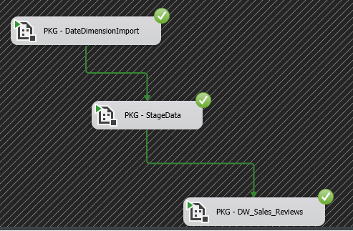
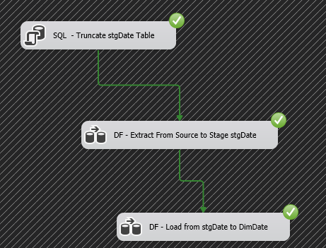
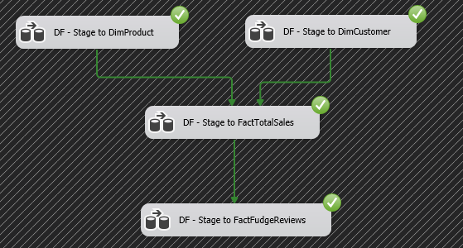
ETL
Stage
ETL packages execution
Date Import execution
DW Import execution

Slide 7
Business Intelligence - Reporting
Sales
By Region
By Category
By Products
By Date/Time
Product Reviews
By Region
By Product
By Date/TIme

Slide 8

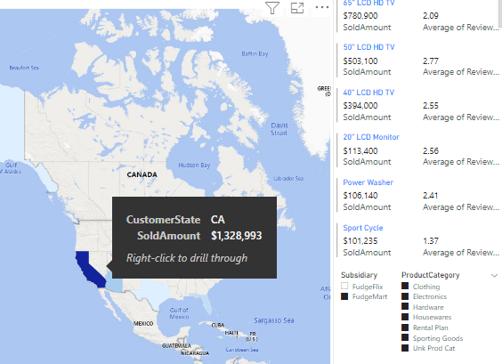
BI Dashboard Sales Map
Review sales data on interactive map for any combination of subsidiary and product category

Slide 9
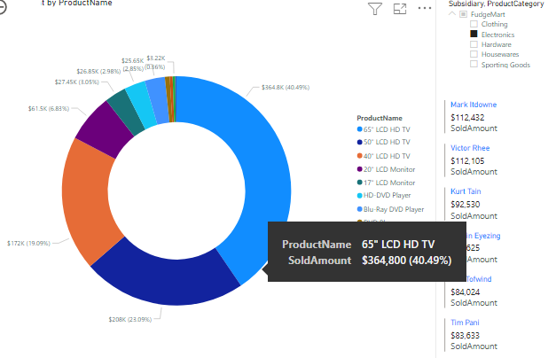
BI Dashboard Product Mix
Review product sales mix for any region and category while showing top customers.

Slide 10
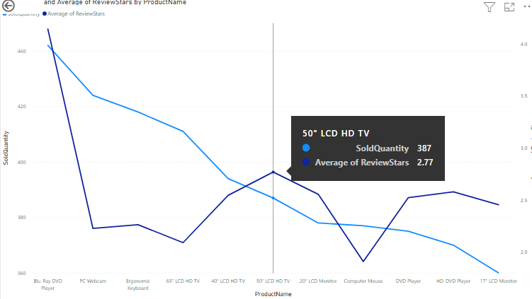
BI Dashboard Category Analysis
Review quantity sold versus average product ratings for selected markets.

Slide 11
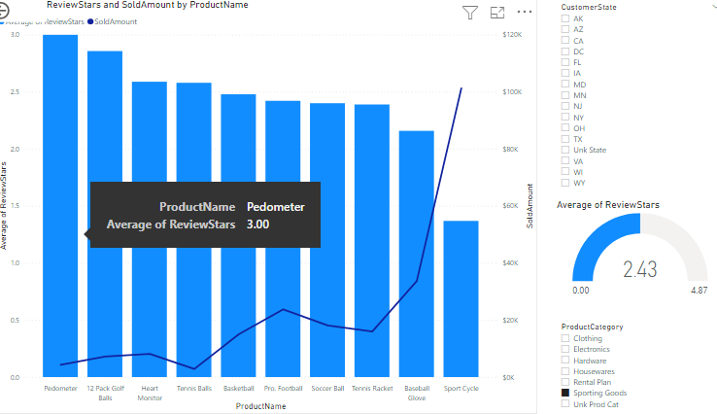
BI Dashboard Ratings Analysis
Review ratings and sales for selected product categories by desired market(s).

Slide 12
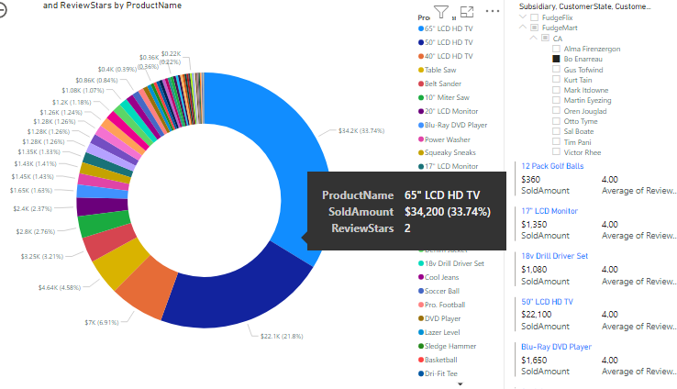
BI Dashboard Customer Analysis
Review product mix and highest rated products by selected customer(s).

Slide 13
Questions?
Thank you all

